Slide 1
Our Mill
By :- Hari Priya.V

Slide 2
Contents
Introduction
System Requirements
Implementation
Conclusion

Slide 3
Introduction
The objective of Our Mill is to allow the administrator of organization to edit and find out the details of any product’s and to update new product’s.
It also facilitates keeping all the records of products, such as name, price and quantity. So all the details of product’s will available for the customer’s to order product’s.

Slide 4
System Requirements
Operating System - Windows 10.
Platform – Notepad++.
Language – HTML, CSS, JavaScript.

Slide 5
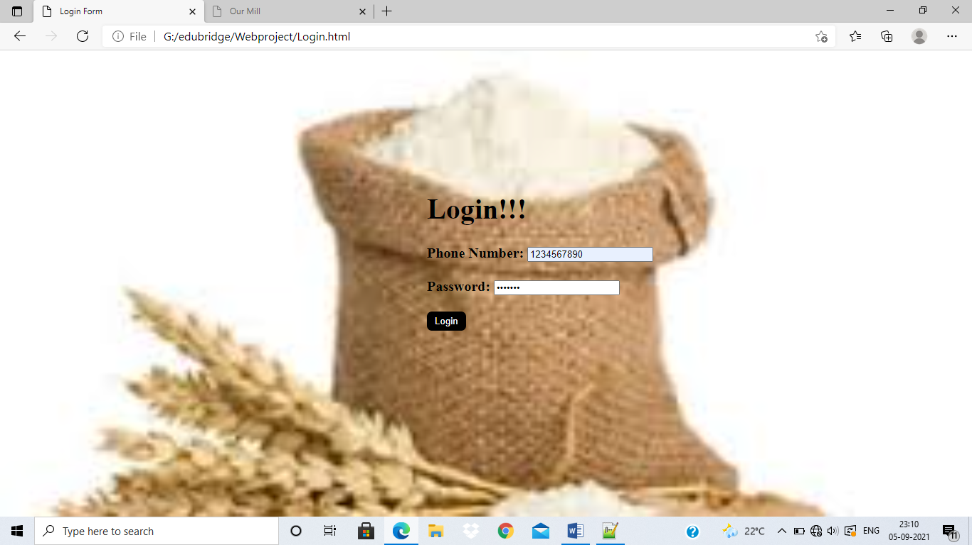
Implementation
Login Page

Slide 6
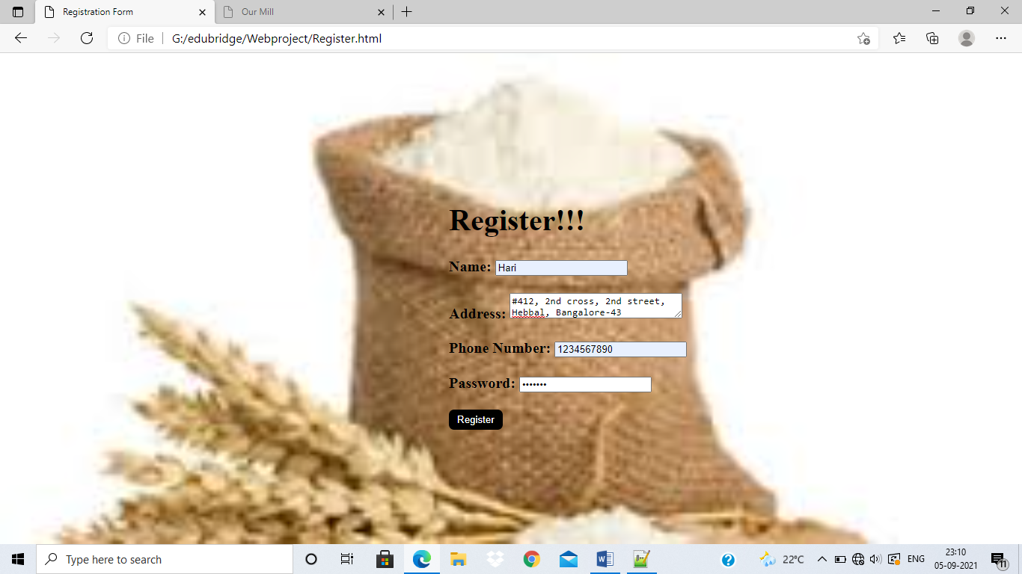
Registration Page

Slide 7
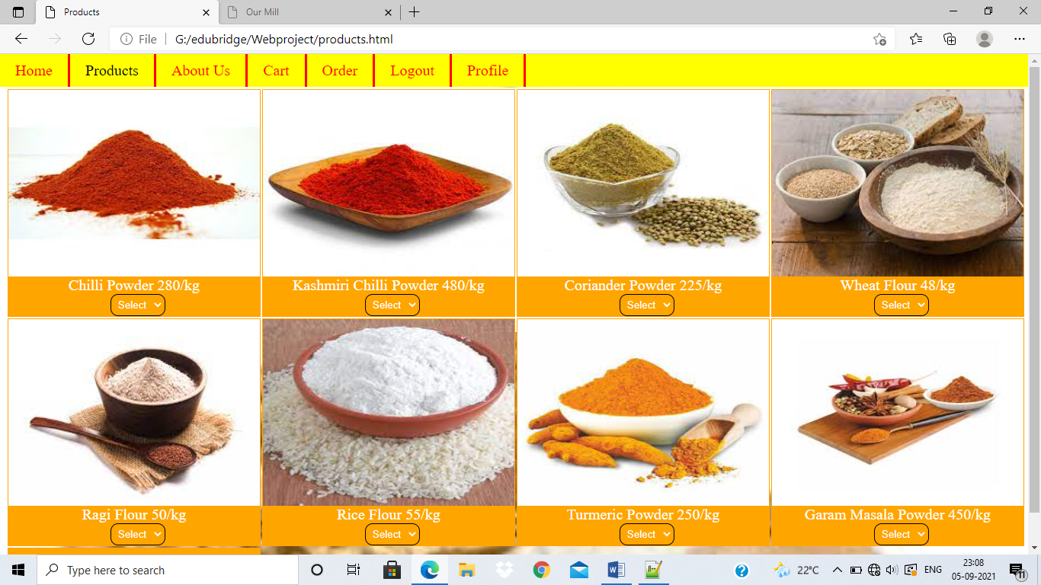
Products Page

Slide 8
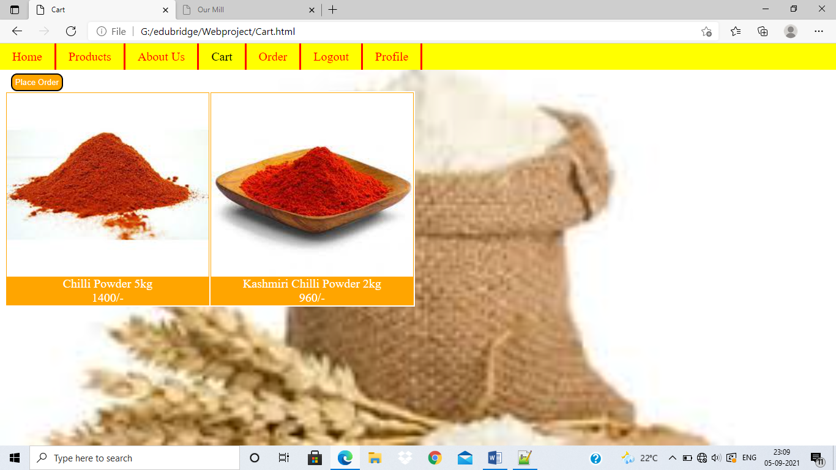
Cart Page

Slide 9
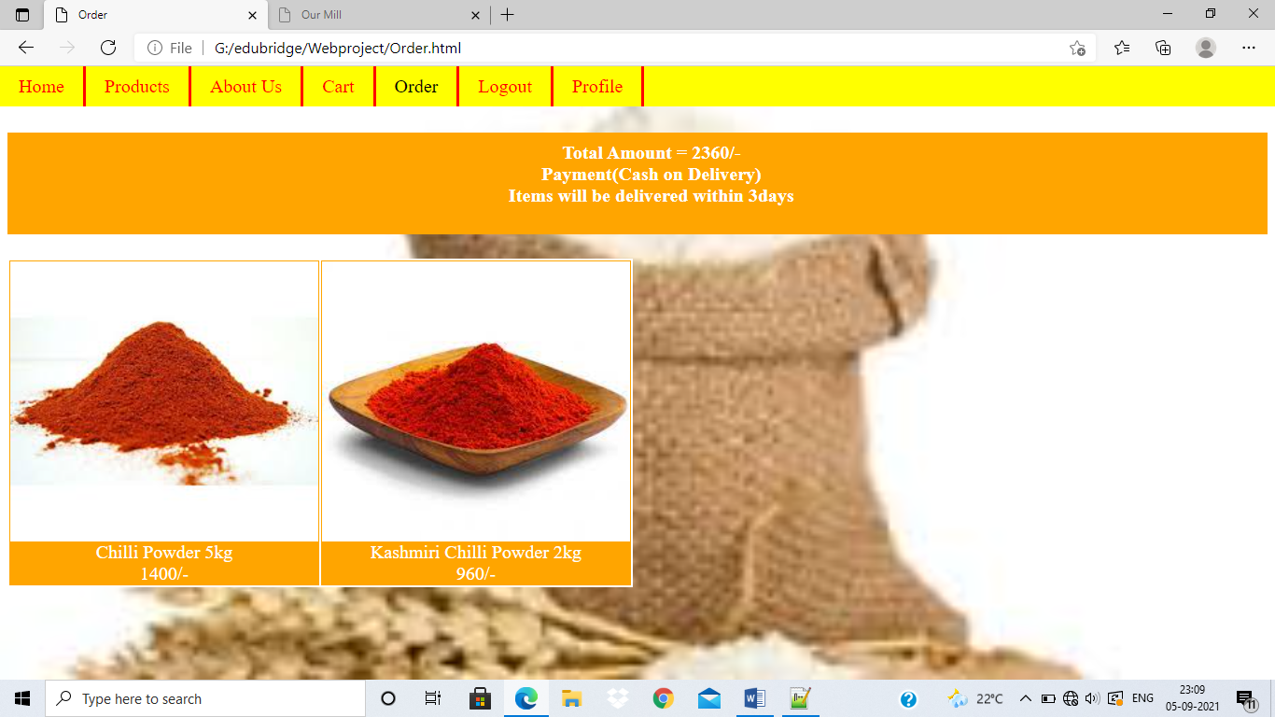
Order Page

Slide 10
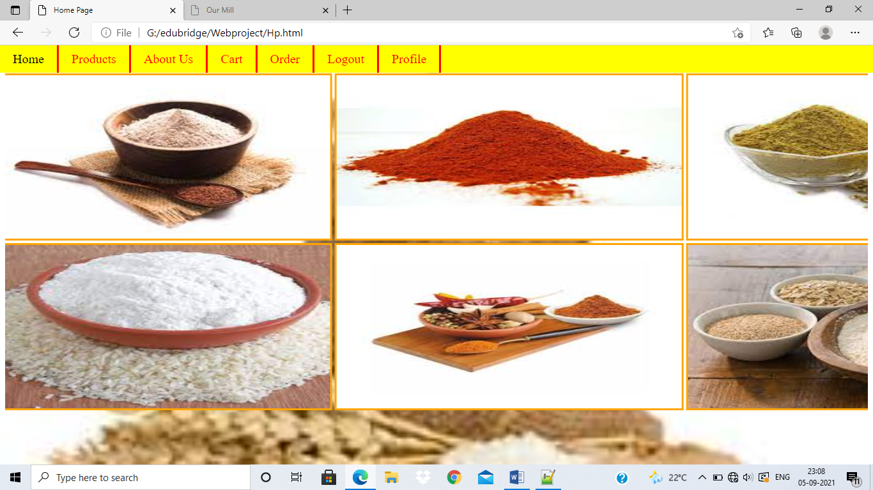
Home Page

Slide 11
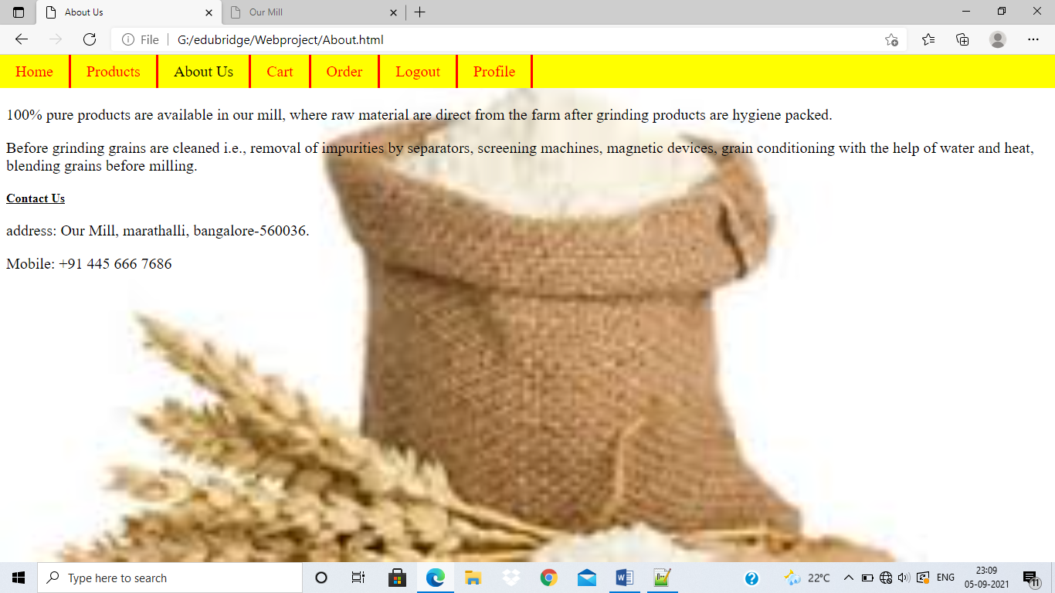
About Page

Slide 12
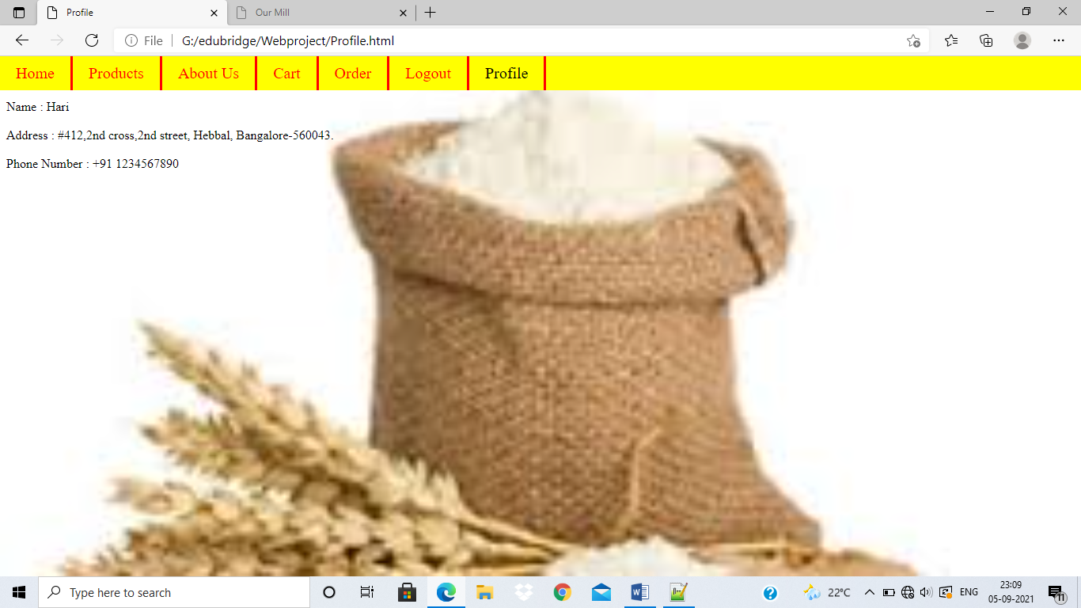
Profile Page

Slide 13
CONCLUSION
Our Mill will reduce the time of customer’s in visiting the mill, instead customer can order through online and get their products based on their choices with reasonable price. Products will be given at their door-step.

